Slide 1

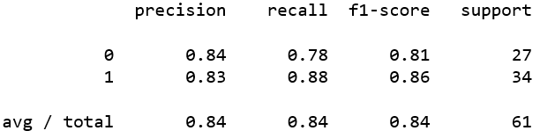
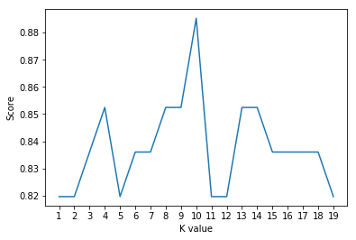
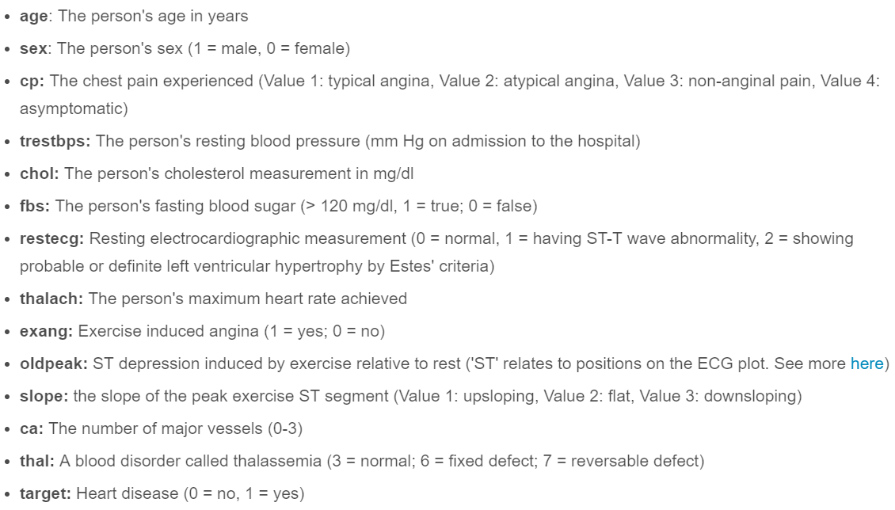
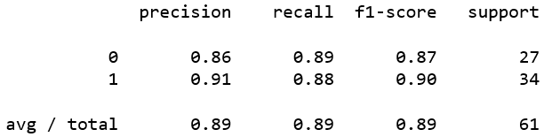
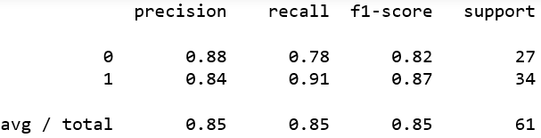
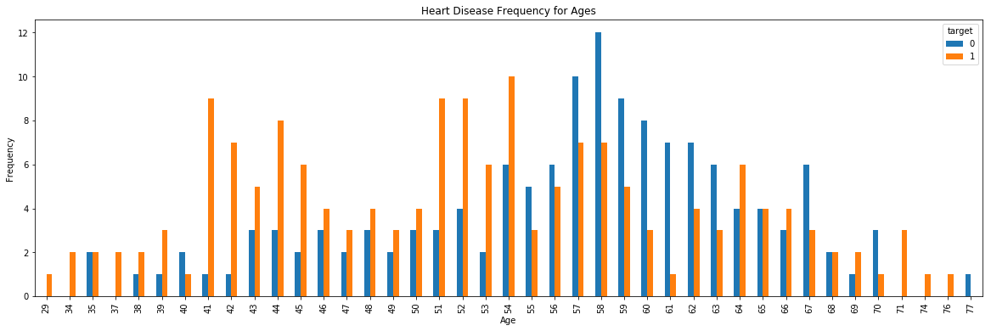
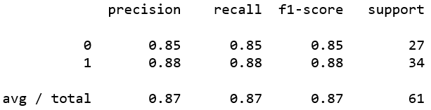
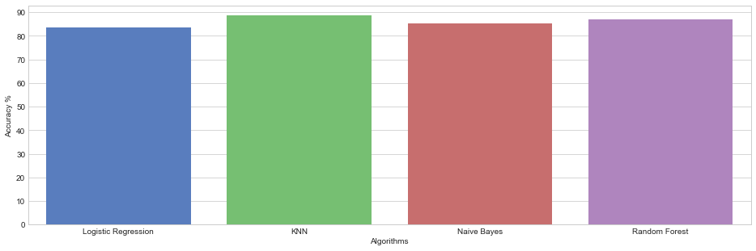
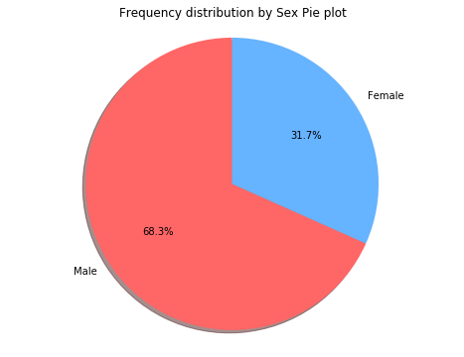
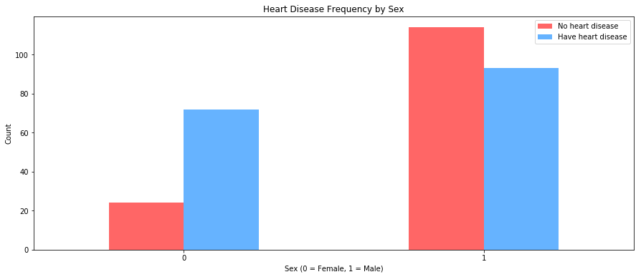
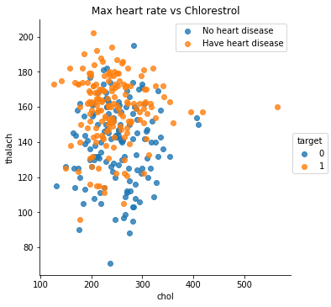
Heart Disease Classification Study Gaurav Sawant Advisor: Amir H. Gandomi
Statistical Learning & Analytics
Spring, 2016
Introduction: Problem
Aim is to use classification methods to predict the presence of heart disease using the health & other attributes of patients
Accuracy is critical in health-related problems & hence multiple classification techniques are tested for performance
Results & Evaluation
Logistic Regression (Accuracy = 83.60%)
K-Nearest Neighbors (k = 10, Accuracy = 88.52%)
Naïve Bayes (Accuracy = 85.24%)
Random Forest (Accuracy = 86.88%)
Comparison of Accuracy of Classification algorithms
Comparison of Classification Algorithms
Pred | 0 | 1
0 | 21 | 6
1 | 4 | 30
Data & Data Processing
Dataset named ‘Heart Disease UCI’ obtained from kaggle
Data has health & other attributes about patients
Target variable explains absence or presence of heart disease
330 rows, 14 columns, no missing values
Variable Description
Data Processing: All variables are numeric. Only scaling performed
Pred | 0 | 1
0 | 24 | 3
1 | 4 | 30
Pred | 0 | 1
0 | 21 | 6
1 | 3 | 31
EDA
Pred | 0 | 1
0 | 21 | 6
1 | 3 | 31
Conclusion
All the classification models tested return very good results with high accuracy
As seen above, K-Nearest Neighbors with k=10 returns the highest accuracy
K is usually chosen as an odd value and k=5 is the most common value of k. k=10 doesn’t follow both these norms
In case value we choose a value of k other than 10, Random Forest becomes the algorithm having highest accuracy

